Slide 1
INVENTORY MANAGEMENT SYSTEM
LAVANYA K-192121084 JAYARAGINI R-192110525

Slide 2
INTRODUCTION
Inventory management refers to the process of ordering, storing, using, and selling a company's inventory. This includes the management of raw materials, components, and finished products, as well as warehousing and processing of such items..

Slide 3
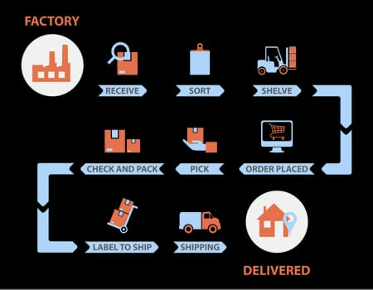
HOW INVENTORY WORKS ?

Slide 4
KEY COMPONENTS:
Stock Tracking Software:
Tracks inventory to show how much stock is available at any moment.
Supplier Management:
Manages relationships with suppliers to ensure products are restocked on time.
Inventory Valuation:
Helps calculate the value of inventory using methods like FIFO or LIFO
Order Fulfillment:
Manages the process of receiving, processing, and shipping orders accurately.

Slide 5
HARDWARE REQUIREMENTS:
Server:
Processor: Intel i5
RAM: 16 GB or higher
Workstations:
Processor: Intel i3 or equivalent
RAM: 8 GB or higher
Storage: 500 GB HDD or SSD
Barcode Scanners: To track inventory in real-time.
Network Infrastructure: Routers and switches for communication between devices.

Slide 6
SOFTWARE REQUIREMENTS:
Database Management System (DBMS):
SQL-based (e.g., MySQL, PostgreSQL, or Microsoft SQL Server)
Data Warehousing:
ETL tools (e.g., Apache Kafka, Talend) to extract, transform, and load data
4.Programming Language:
SQL for database queries
Backend development (e.g., Python, Java, or Node.js)
Frontend (e.g., React or Angular)

Slide 7
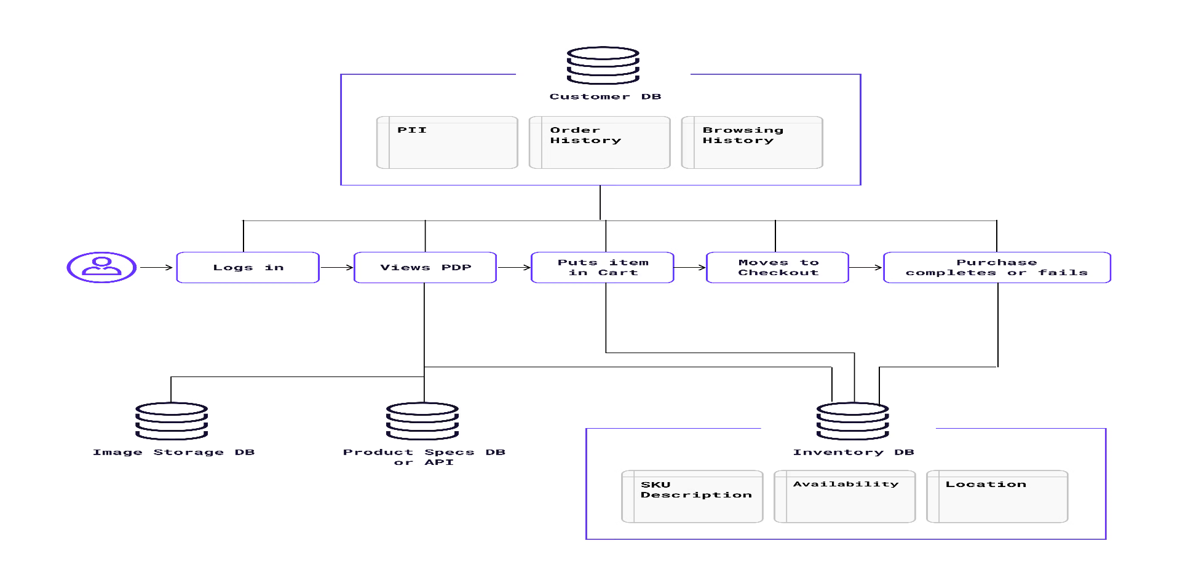
ARCHITECTURE DIAGRAM:

Slide 8
TECHNOLOGIES USED:
Database Management System (DBMS):
For managing and querying inventory, sales, and supplier data efficiently.
Data Warehousing : ETL Tools for extracting, transforming, and loading data to improve trend analysis and reporting
Structured Query Language(SQL):
For database queries and real-time stock tracking.

Slide 9
IMPLEMENTATIONS:
1. Plan Phase: Identify functionality and layout for successful implementation. 2. Development Phase: Create the software architecture based on requirements and specifications. 3. Testing Phase: Conduct thorough testing to ensure system reliability and performance. 4. Deployment Phase: Launch the system, providing training and support to users.

Slide 10
FUTURE TRENDS IN INVENTORY MANAGEMENT SYSTEM:
1. Predictive Analysis: Leveraging data analytics to forecast demand and optimize stock levels efficiently. 2. IOT Integration: Utilizing Internet of Things devices to track inventory in real-time, enhancing visibility and control. 3. Blockchain Technology: Using blockchain to enhance security in supply chain transactions and inventory records.

Slide 11
Thank you!
+91 620 421 838

